Slide 1

How Important to Our Democracy is Immigration?

Slide 2
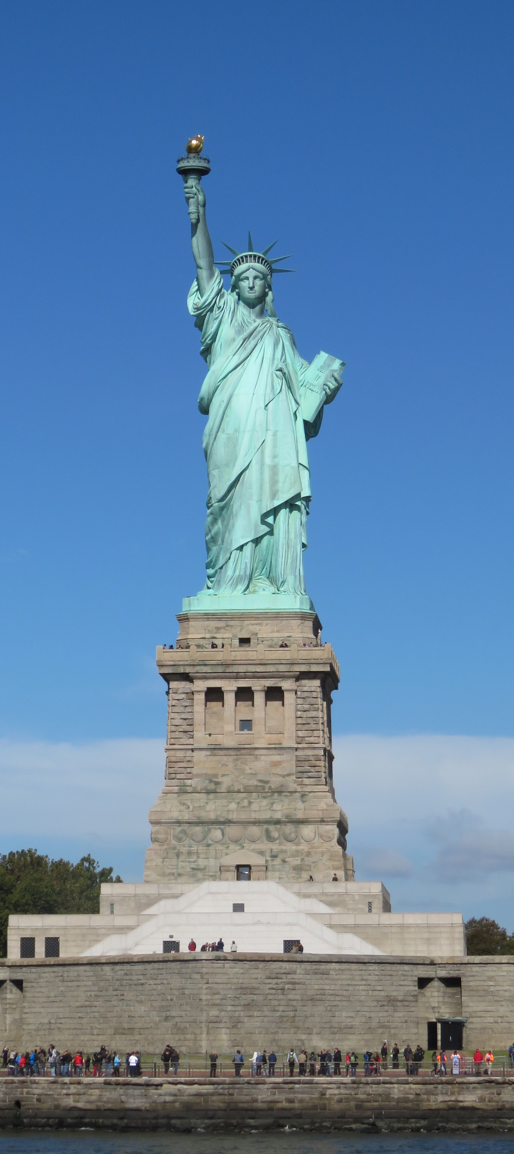
The New Colossus - Emma Lazarus (1883)
Not like the brazen giant of Greek fame,
With conquering limbs astride from land to land;
Here at our sea-washed, sunset gates shall stand
A mighty woman with a torch, whose flame
Is the imprisoned lightning, and her name
Mother of Exiles. After her beacon-hand
Glows world-wide welcome; her mild eyes command
The air-bridged harbor that twin cities frame.
“Keep, ancient lands, your storied pomp!” cries she
With silent lips. “Give me your tired, your poor,
Your huddled masses yearning to breathe free,
The wretched refuse of your teeming shore.
Send these, the homeless, tempest-tost to me,
I lift my lamp beside the golden door!”
Notes:
https://www.poetryfoundation.org/articles/144956/emma-lazarus-the-new-colossus

Slide 3

Is America A Nation of Immigrants?
Before we can discuss the benefits or drawbacks of immigration we have to decide how important immigration to the US has been throughout history.
To do this - you and your partner will explore interactive maps that use Census data on the New American History website.
What did you decide?
Notes:
Lesson borrowed from https://resources.newamericanhistory.org/foreign-born

Slide 4
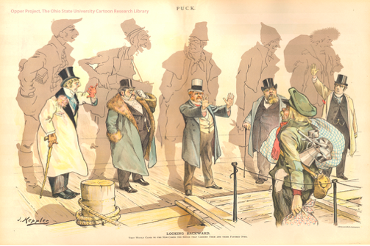
Immigration Cost-Benefit Analysis
A cost-benefit analysis is a way of determining the value of an item, idea, or intervention. It usually involves financial statements - but ours will include other aspects.
You will be given a few sources to explore with your partner - as you read, note the benefits and costs of new immigrants to the US.
“Looking Backward” from Puck magazine, 1893
Notes:
Information about the cartoon - https://hti.osu.edu/opper/lesson-plans/immigration/images/looking-backward

Slide 5

Discuss

Slide 6

Finally - show me what you know!
What did you decide? Is immigration a positive? Does it add or detract from our democracy? How about other marginalized groups? Is it important that they be included in our American ideals?
Create a Public Service Announcement (PSA) promoting your ideas! It could be a commercial PSA, a poster, perhaps a podcast, or an interview with an immigrant - create something you would be proud to share with your school!

